Slide 1
Financial Statement Fundamentals
Queen's Master of Management in Analytics
Tutorial Session – May 4, 2020
Gary J. Bissonette

Slide 2
MMA 801 Tutorial – Financial Fundamentals
Tonight’s Agenda
10 Rapid Fire Questions
Framing the Larger Picture
Understanding Base-level Financial Fundamentals
Identify Key Interpretative Conclusions Surrounding the Three Core Financial Statements
Statement of Comprehensive Income
Statement of Changes in Financial Position (Balance Sheet)
Statement of Cash Flows

Slide 3
Quick Assessment
On a scale of 1 – 10, with 10 being excellent…how would you rate your understanding of the composition and interpretation of financial statements?
1 to 3
Limited
4 to 6
Okay
7 to 8
Competent
9 to 10 Excellent
Response
1 to 3
4 to 6
7 to 8
9 to 10

Slide 4
Quick Assessment
On a scale of 1 – 10, with 10 being excellent…how would you rate your understanding of the concepts of…
Liquidity and Solvency
Financial capacity and velocity
Breakeven Analysis
1 to 3
Limited
4 to 6
Okay
7 to 8
Competent
9 to 10 Excellent
Response
1 to 3
4 to 6
7 to 8
9 to 10

Slide 5
MMA 801 – Tutorial – Financial Fundamentals
Housekeeping Items – Support Materials
Textbook Readings
Chapters – 13, 14, & 15
Great "Quick Read" – Financial Statement Interpretation
Warren Buffett and the Interpretation of Financial Statements, written by Mary Buffett and David Clark, published by Scriber (available via Amazon.ca or Chapters.ca).
Copies available via the MMA resource library. Toronto Campus library has a limited number of copies for check out.

Slide 6
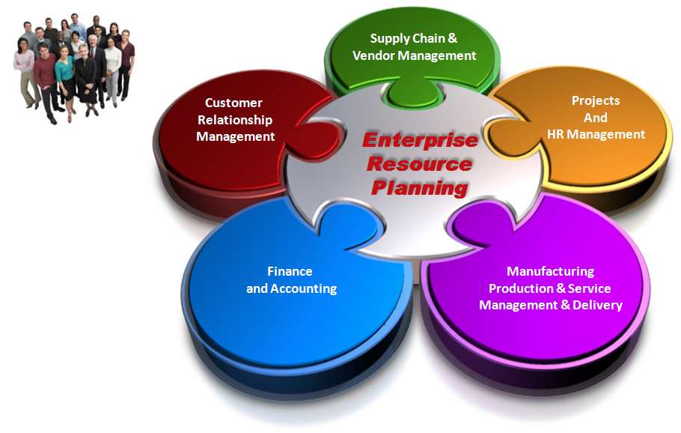
MMA 801 – Tutorial – Financial Fundamentals
Quick Point of Clarification
It is recognized that a number of you may work with companies which utilize an ERP-style software platform for strategic and financial integration purposes.
The intent of this tutorial is not to focus on this integration component. Its intent is to provide the underlying logic and basis of financial decision-making, and the corresponding aggregate financial statement structure which supports it.
It is this underlying logic which is then translated into the ERP decision-making environment and forms the fabric of financial conclusions.

Slide 7
MMA 801 – Tutorial – Financial Fundamentals
Do you understand these terms?
Profit Formula Liquidity
Cost Structure & Drivers Solvency
Cost Ladder Capacity
Depreciation Velocity (Turnover)
Cash Flow Positive KPIs or KPMs
Breakeven Point
Margin Management Discounted Cash Flow
Cash Operating Cycle
Capitalization

Slide 8
10 Rapid fire questions (Poll response)
MMA 801 – Tutorial – Financial Fundamentals

Slide 9
Financial Fundamentals Tutorial
Which financial statement reports an organization’s profit over an identified period of time?
Statement of Changes in Financial Position (Balance Sheet)
Statement of Comprehensive Income (Income Statement)
Statement of Cash Flow
Proforma Statement
Statement of Changes in Capital Investment Deployed
An assessment of an organization’s future financial capacity is best found by assessing which financial statement?
Statement of Changes in Financial Position (Balance Sheet)
Statement of Comprehensive Income (Income Statement)
Cash Flow Statement
10Q Statement
Operating Budget

Slide 10
Financial Fundamentals Tutorial
Companies which are profitable can be assumed to be liquid and solvent?
True
False
4. Which statement(s) best define an organization’s liquidity position?
Statement of Changes in Financial Position (Balance Sheet)
Statement of Comprehensive Income (Income Statement)
Statement of Cash Flow
a. & c.
a. & b.

Slide 11
Financial Fundamentals Tutorial
5. An organization’s future performance can be best assessed by reviewing which of the following:
Statement of Changes in Financial Position (Balance Sheet)
Statement of Comprehensive Income (Income Statement)
Statement of Cash Flow
Historical Trends
None of the above, by themselves, provide significant insight into future performance
6. Increases in revenue directly equate to (result in) increases in profits?
True
False

Slide 12
Financial Fundamentals Tutorial
What are the three primary sources of capital available to for-profit business organizations?
Internal, working capital, divestitures
Trade credit, line of credit, bonds
Internal Sources (i.e. cash, working capital,, etc.) credit facilities, equity offerings
Retained earnings, cash, debt financing
None of the above
Retained Earnings identify the total amount of capital available to an organization.
True
False

Slide 13
Financial Fundamentals Tutorial
“Working Capital” is computed (determined) by which of the following formulas?
Quick Assets – Current Liabilities
Current Assets – Retained Earnings
Current Assets – Current Liabilities
Total Assets – Total Liabilities
None of the above
On the Statement of Changes in Financial Position (Balance Sheet), if Total Liabilities exceed Total Assets then Shareholder Equity…
Is set to “0”
Becomes negative
Remains positive, and is set to the current cash balance identified on the Balance Sheet
Is automatically restored to “0” via a government-supported “line of credit” guarantee
Is not impacted and reflects the original investment made by investors

Slide 14
The big picture – The Concept of “Capital” (gaining perspective)
MMA 801 – Tutorial – Financial Fundamentals

Slide 15
MMA 801 – Tutorial – Financial Fundamentals
C-Suite (Top Management/Owner)
Responsibility
Business Model Development & Management
Vision and Strategic Intent
Tangible Assets
Talent
Intellectual Prop.
Financial Capital
Culture of Continuous Innovation
Resource Timing, Allocation and Procurement
Short-term Profitability
Long-Term Position and Growth
Responsible Asset Development and Social Awareness & Adherence
Notes:
Active and/or Market Inertia – refers to permeation into the culture and the decision-making process of static market and operational assessment. Results include expense creep thereby eroding margin and price competitiveness, cost bloating, myopic assessment of business opportunity, budgetary reliance to drive business decisions, as well as loss of market positioning due to value curve attribute shifts, and/or changes in the business landscape (disruption). Such scenarios result in degradation of the revenue and/or profitability model.

Slide 16
MMA 801 – Tutorial – Financial Fundamentals
The Broader Business Model
Culture, Structure & Mgmt. Systems
Customer Value Proposition
(Effective, Reliable, Affordable, Convenient Solutions)
Critical Resources
(People, Assets, Capital, Technology, Brand)
Critical Processes
(Repeatable, Scalable, Sustainable)
Profit Formula
(Revenue model, cost structure, target margins, resource velocity)

Slide 17
Here is The Capital Challenge
MMA 801 – Tutorial – Financial Fundamentals
Organizations possess an ongoing thirst for capital…invest to innovate and grow, create a buffer of resiliency in down times etc.
The ability to acquire capital and effectively use it to drive revenue (from new or existing sources), profitability, and positive cash flow is what develops competitive advantage and long-term business sustainability.
Access to capital means the ability to do the above.
Just remember…dollars spent today may not be available tomorrow, thus managers need to establish priorities and direction relating to capital allocation. The fundamental core financial metric is ROIC (also referred to as ROCE).

Slide 18

MMA 801 – Tutorial – Financial Fundamentals
From a "Capital" perspective…
Managing a company is all about understanding its cash flow and managing cash relationships.

Slide 19
Business $$$ Value Drivers
MMA 801 – Tutorial – Financial Fundamentals
Organizational Wealth & Shareholder Value
Net Cash Flow
Capital Structure
Financing Model & Cost of Capital
Resource Consumption Model
Revenue Model
Profitability, although important, is not necessarily the core financial metric when we look at long-term wealth creation.

Slide 20
MMA 801 – Tutorial – Financial Fundamentals
Business Model Analysis
In Summary – Your business model defines the execution of this equation.
Price
Compared actual to projected results – DCF anticipated outcomes
Unit
Margins
Minus
Cost
Net
Income
Return On
Invested Capital – ROIC (ROCE)
Times
Market
Share
Divided
By
Unit
Volumes
Times
Assets
Deployed
Market
Size

Slide 21
MMAI 801 – Tutorial – Financial Fundamentals
Simple Formula – Profitability
Profit aggregate = Total Revenue – Total Cost
Profit aggregate = (Selling Price Unit x Quantity Sold) – (Total Cost Unit x Quantity Produced)
Profit Unit = Selling Price Unit – Total Cost Unit
Profit = TR – TC
Profit = (SP x QS) – (TC x QP)
Profit (unit) = SP unit – TC unit

Slide 22
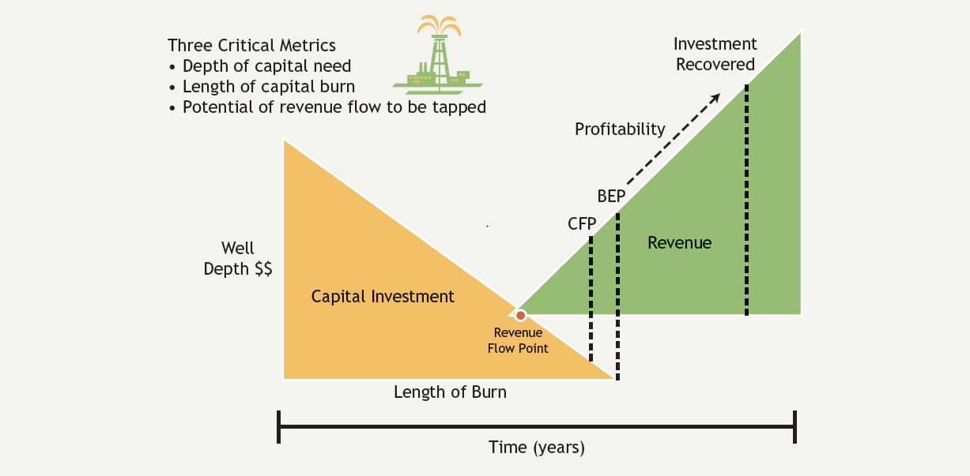
MMA 801 – Tutorial – Financial Statements
Capitalization Well – Depth & Length of Burn
Understanding Capital Deployment
Cash Outflows
Cash Inflows

Slide 23
MMA 801 – Tutorial - Financial Fundamentals
Analytics, AI and Profit Model
Price Strategies
Data, Judgement, Actions
Looking to reduce the costs of inputs (prediction)
Recognize and articulate the “ripple” effect of input reduction
Define and Increase the predicted value of outputs
Think beyond operational efficiency to business model transformation
If we reduce price by 5% to enhance volume, will we improve profit?
Margin
Cost Strategies
The critical component here is prediction accuracy…do you know what to predict?
Net Income
Market Share
Strategies
Can we increase EBITDA by x%
Volume
Market Size
Strategies

Slide 24
MMA 801 – Tutorial - Financial Fundamentals
Capital Deployment
Capital Deployment Outcomes
Capital Inputs
Strategic Initiative
Internal Capital Sources
Markets
Processes/Activities
External Capital Sources
Assets
Technology
Statement of Comprehensive Income
Statement of Changes in Financial Position
Statement of Cash Flows
Statement Derivatives
Liquidity
Solvency
Capacity
Velocity

Slide 25
Key Financial Conclusions Relating to Capital Management
MMA 801 – Tutorial – Financial Fundamentals
Ability
To meet immediate and short-term obligations
Degree of asset liquidity potential
Ability
To generate positive cash flow
Meet long-term obligations
Financial Liquidity
Financial Solvency
Financial Capacity
Financial Velocity (COC)
Ability
Relating to capital possessed,
Additional borrowing
Strength relative to rivals
Effectiveness of capital deployment, payback & COC

Slide 26
MMA 801 – Tutorial – Financial Fundamentals
Two Impact Zones relating to "Capital" deployment & management
Sales Revenue
Direct Operating Expenses
Indirect Operating Expenses
Interest on Debt
Tax Obligations
Operational Transactions
Capital Management Impact
Capital Asset Transactions
Asset Investments
Asset Divestitures
Issue or Retire Stock
Issue or Retire Credit Facilities
Pay Dividends

Slide 27
Neiman-Marcus & J.C. Penney – Examples
MMA 801 – Tutorial – Financial Fundamentals
Capital Structure Illustration

Slide 28
Part 2 – Financial Statement Analysis
MMAI 801 – Financial Fundamentals – Tutorial

Slide 29
MMA 801 – Tutorial – Financial Fundamentals
Key Understanding/takeaways Regarding Financial Statements
Statements are outcomes of managerial decisions and operating execution of your business model for a defined period of time.
Statements are historical in nature.
Statements represent a snapshot at a given period of time.
Statements are susceptible to "Masking".
Statements should not be looked at in isolation, but need to be combined with operational, marketing and business-based metric (KPMs) results and movement.

Slide 30
This Is What Needs to Be Understood & Managed
MMA 801 – Tutorial – Financial Fundamentals
Financial Risk Analysis Focus
Revenue Model
Cost Structure, Drivers, and laddering
Capitalization, Structure & Requirements
(ROIC)
Margin Requirements
CFP & BEP
Cash Cycling (COC)
& Velocity
Interpreting our financial structure and results and monitoring changes to our business system operation assists us in drawing conclusions relating to these key areas.
Notes:
In pro-forma analysis, the underlying assumptions is what drives the credibility of the decision-making process.

Slide 31
MMA 801 – Tutorial – Financial Fundamentals
Financial Statement Focus (The Drill Down)
Statement of Comprehensive Income
Statement of Changes in Financial Position
Statement of Cash Flows
Organizational Focus
Operations Decisions & Transactions
What we own, owe, and have accomplished
Movement of Cash across the organization
Assessment Focus
Revenue vs. Expenses & Margin Mgmt.
Asset and Ownership Structure
Asset base and financing transactions
Working Capital, Capital Capacity, Asset Productivity
Core Metric
Net change in cash position
Profit or Loss

Slide 32
Financial Statement Integration (Simplified Statements)
MMA 801 – Tutorial – Financial Fundamentals
Statement of Changes in Financial Position or Balance Sheet
(Organizational Assessment)
Assets
Cash
Near Cash
Accts Receivable
Current Assets
Long Term Assets
Total Assets
Liabilities
Current Liabilities
Long-Term Liabilities
Owner's Equity
Invested Capital
Retained Earnings
Statement of Comprehensive Income or Income Statement
(Operational Assessment)
Revenue
- COGS
= Gross Profit Margin
Indirect Expenses
= EBIT
Interest Expense
= EBT
Taxes
= Profit/Loss
Statement of Cash Flows
Net +/- Results from Income Statement
+
Net +/- Non-Cash Items
such as Depreciation
+
Net Cash +/-from Investing Activities
+
Net Cash +/- from Financing Activities
=
Change to Cash Position

Slide 33
MMA 801 – Tutorial – Financial Fundamentals
Financial Statements – Managerial Decision-making Analysis
Historical Trends
Comparatives – Year-over-year (YoY)
Quarter-over-Quarter (QoQ)
Industry & Sector Comparatives
Current Results
Recent Quarterly Results
Year-to-Date Results
Trailing Twelve Months (TTM) Results
Projected Outcomes
Pro-Forma Budgets – Sales Forecasts
New Venture Projections
Capital Commitments & Requirements
Here is what is trending…
Here is what we need to do
Time

Slide 34
MMA 801 – Tutorial – Financial Fundamentals
Recognizing the Time Lag
Current Q
Rev = -3%
Q+1 Results = -3%
Q+2 Results = -3% additional
Q+3 Results = -3% additional
Q+4 Results = -2% additional (Turnaround)
Revenue and market share are continuing to decline
We need to jump on this and establish a plan to respond
Actions are in place…will take time to remedy
We think its
Seasonal…or event specific
Let’s monitor the situation… watch the upcoming quarter
Not seasonal…where is the leakage to the customer formula
CB = (EC+NC)-DC
It is a priority…everyone is addressing this…we are getting on it…temporary measures are in place
We now understand what is happening…we are executing the plan

Slide 35
MMA 801 – Tutorial – Financial Fundamentals
Examples - KPIs (Key Performance Indicators or KPMs (Key Performance Metrics)
Area | KPMs or KPIs | Think in Terms Of
Marketing | Customer Acquisition Costs Market Share Movement Customer Churn Unit Volume Movement Load Factors Cost per click Customer Lifetime Value (CLV) | What has to be measured Who/how it will be measured Time interval of assessment Frequency of review What is it not telling us
Operations | Quality/Defect Tracking Stock outs Tolerance Adherence Delivery Time Transportation Costs Concept to Market Time
Financial | Aggregate ROS, ROA, ROI, GPM, OM Specific ASP, FOP, COC, AR and AP Movement, Customer Profitability
HR | Productivity Absenteeism Turnover
Your Business Dashboard

Slide 36
Statement of Comprehensive Income – Your Operating Lens
MMAI 801 – Financial Fundamentals – Tutorial

Slide 37
Quick Assessment
On a scale of 1 – 10, with 10 being excellent…how would you rate your understanding of the composition and interpretation of the Statement of Comprehensive Income?
1 to 3
Limited
4 to 6
Okay
7 to 8
Competent
9 to 10 Excellent
Response
1 to 3
4 to 6
7 to 8
9 to 10

Slide 38
Simplified Statement of Comprehensive Income
MMA 801 – Tutorial – Financial Fundamentals
NRE = Non-Reoccurring Expenses
Total Revenue $$$$
Less: Direct Operating Expenses $$$$
Equals: Gross Profit Margin $$$$
Less: General Operating Expenses $$$$
Earnings before Interest & Tax (EBIT) $$$$
Less: Interest Expense $$$$
Equals: Earnings Before Taxes (EBT) $$$$
Less: Taxes , Adjustments, NRE $$$$
Equals: Net Profit or Loss $$$$
Selling Price x Quantity Sold
Cost of Goods Sold
Key Metric – What is left to pay all other expenses
Gross Margin
SG&A
Fixed, Semi-Fixed, Committed
What the operation is delivering
Fixed Payments on Debt
Key Metric - Earnings after cost of debt is deducted
Operating Margin
Depends on current earnings and carry forwards
Key Metric - What we actually have to work with
Net Margin

Slide 39
Statement of Comprehensive Income – $1.00 Relationship
MMA 801 – Tutorial – Financial Fundamentals
$1.00
Product Portfolio(s)
Revenue
Product Costs
Profit = Revenue – Total Costs
or on a per unit basis
Profit = Price – Total Cost
Gross Profit
Margin
Indirect Costs
Interest Expense & Taxes
Operation Margin
Net Income

Slide 40
MMA 801 – Tutorial – Financial Fundamentals
In a simple chart-based illustration, here is what the Statement of Comprehensive Income tells you
Revenue
Profit Zone
Total Costs
BEP
$$$
Direct Cost Base
Operating Loss Zone
Indirect Cost Base (FC, SFC, CC)
Business Model Execution – Activity

Slide 41
MMA 801 – Tutorial – Financial Fundamentals
Key Financial Conclusions – Statement of Comprehensive Income
Revenue Model
Cost Structure Analysis
Portfolio Revenue Stratification
Where are the $$$ coming from – specific product trends
Customer Base Formula Trends
CB = (EC + NC) - DC
ASP, FOP and ART Trends
Masking Conclusions…what are we not seeing
Impact to BEP and Profit Model
Existing and trending cost structure
Cost Ladder changes
Existing and trending cost drivers
Controllability of costs
Operational investment requirements
Non-operational decision(s) impact trends
Expense Creep
Impact to BEP and Profit Model
Financial Metrics = GPM, OM, EBIT, EBITDA, ROS, ROA, ROE, EPS, Interest Coverage
ASP = Average Selling Price
FOP = Frequency of Purchase
ART = Average Revenue per Transaction

Slide 42
Statement of Changes In financial position & statement of cash flows
MMAI 801 – Financial Fundamentals – Tutorial

Slide 43
Quick Assessment
On a scale of 1 – 10, with 10 being excellent…how would you rate your understanding of the composition and interpretation of the Statement of Changes in Financial Position (Balance Sheet)?
1 to 3
Limited
4 to 6
Okay
7 to 8
Competent
9 to 10 Excellent
Response
1 to 3
4 to 6
7 to 8
9 to 10

Slide 44
MMA 801 – Tutorial – Financial Fundamentals
Statement of Changes in Financial Position
(Balance Sheet)
Here is What We Own
"Assets"
Here is Who Owns It
"Creditors"
"Us (equity)"

Slide 45
MMA 801 – Tutorial – Financial Fundamentals
Assets – What The Company Owns
Liabilities and O.E. – Who Owns It
Current Assets
Cash, Short-Term Investments, Accts. Receivable, Inventory
Current Liabilities
Accounts Payable, Short-Term Debt, LOC Obligations, Deferred Revenue, etc.
Long Term Assets
Land, Buildings, Durable Equipment, Patents, Goodwill, etc.
Long-Term Liabilities
Long-Term Debt
Lease Obligations, etc.
$$$
$$$
Owners' Equity
Paid-in Capital
Retained Earnings
Assets = Liabilities + Owners' Equity
Statement of Changes in Financial Position (Balance Sheet)

Slide 46
Statement of Changes in Financial Position (Balance Sheet) – Core Reflections
MMA 801 – Tutorial – Financial Fundamentals
A = L + E… Assets = Liabilities + Owners' Equity
Working Capital (CA – CL)
Current & Quick Ratios
Debt to Asset – (% of encumbrance, leverage)
Equity to Asset – (what we truly own)
Retained Earnings – prior profitability

Slide 47
Quick Assessment
On a scale of 1 – 10, with 10 being excellent…how would you rate your understanding of the composition and interpretation of the Statement of Cash Flows?
1 to 3
Limited
4 to 6
Okay
7 to 8
Competent
9 to 10 Excellent
Response
1 to 3
4 to 6
7 to 8
9 to 10

Slide 48
MMA 801 – Tutorial – Financial Fundamentals
Statement of Cash Flow
Ties together financial decisions and results relating to capital asset transactions and operational transactions.
Integrates with the Balance Sheet to define liquidity, solvency and capacity improvements and/or degradation.
Defines current use of "cash" trends.
Needs to be supplemented with information relating to committed and/or pipeline projects to determine true "cash" position.

Slide 49

MMA 801 – Tutorial – Financial Fundamentals
Statement of Cash Flows reflects the movement of cash in an organization over a period of time…think in terms of commitment, sequencing, tradeoffs, etc.
Current Period Profit
Current Period Deficits
Debt Issuance
Asset Purchases
Stock Issuance
Debt Repayment
Asset Divestitures
Stock Buybacks
Dividend Issuance
Non-cash Acct. Adjust.
Liquidity & Solvency Impact

Slide 50
MMA 801 – Tutorial – Financial Fundamentals
Simplified Cash Flow Summarization
Service-enhancement Initiatives
Subscription-based Revenues (Rental)
Capital Capacity
Cash and Near-cash Reserves
Leverage Capacity
Pre-arranged LOC
Additional Equity Opportunities
Acquisitions
Non-operational Cash Sources
Up-front Asset Purchases
Operational Expenses
Sell and Support Revenue
Dividend Payouts
Cost of Capital
Notes:
Business model underlying premise – reoccurring cash flow revenue model emphasis, backed by capital allocations internally and externally to drive growth and enhance value (shareholder wealth and stakeholder benefit)

Slide 51
MMA 801 – Tutorial – Financial Fundamentals
Cash Velocity Shift
Gross Profit Margin Pressure
Growth via Acquisition Focus
Core Business Model Tensions (Risks)
Increased Business Model Lock-in
Heightened Ecosystem Dependency
Yield-focused Culture
EBITDA and Earnings Pressure
Churn-rate Exposure
Notes:
Pivot…does place some stress on capital capacity and capabilities in the short-term. Given this, I look to draw conclusions relating to increased "stress or tension" on core risk elements which are becoming more factorial in the underlying decision-making and overall effectiveness of the business model.
Short-term Pain for Long-Term Gain with respect to Cash Flow vs. Capital Utilization trade off.

Slide 52
MMA 801 – Tutorial – Financial Fundamentals
Note Pertaining to EBITDA
EBITDA is increasingly being used as a barometer for measuring credit worthiness.
EBITDA is increasingly being accepted as a baseline measure relating to a company’s ability to generate cash.
The risk is three-fold:
It strips out management’s competencies relating to its abilities to manage capital investments and indebtedness.
It reduces the emphasis on longer-term strategic planning and positioning
The definition itself, is subject to massaging, which can lead to potential misrepresentation of a company’s credit worthiness (ex. WeWork)
The key takeaway…ever-increasing adjustments to EBITDA are resulting in significantly higher levels of debt, which may be painting an overly-optimistic picture of a company’s financial strength.
The longer and more complex a definition of EBITDA a company provides, the greater the concern should be of its validity as a true measure of credit worthiness.

Slide 53
MMA 801 – Tutorial – Financial Fundamentals
Operating Results
Financing Activities
Impact to Balance Sheet Cash Balance
Investing Activities
Acct. Adjustments

Slide 54
Quick Assessment
On a scale of 1 – 10, with 10 being excellent…how would you rate your understanding of the concept of “Depreciation”?
1 to 3
Limited
4 to 6
Okay
7 to 8
Competent
9 to 10 Excellent
Response
1 to 3 b) 4 to 6
c) 7 to 8 d) 9 to 10
Do you understand why “Depreciation” is added back when creating a Statement of Cash Flows?
a) Yes b) No

Slide 55
MMA 801 – Tutorial – Financial Fundamentals
Net Results from the Income Statement
Net results from Cash from Operational Activities
Changes to Cash Position
Net results of Cash from Investing Activities
Net results from Cash Financing Activities
Funds used to purchase capital assets. Funds received from the sale of capital assets.
Provides a summary of cash in, cash out and cash surplus/deficit for a defined period
Remember – revenue is not cash!
Adding back of non-cash items, such as depreciation, deferred taxes, and changes in AR and AP levels
Funds received from the issuance of shares or debt. Funds used to repay debt, repurchase shares, and pay dividends.
Simplified Statement of Cash Flows – Flow Illustration

Slide 56
Simplified Statement of Cash Flows
MMA 801 – Tutorial – Financial Fundamentals
Net Results from the Income Statement
Net results from Cash from Operational Activities
Changes to Cash Position
Net results of Cash from Investing Activities
Net results from Cash Financing Activities
Assume profit of $2M
Assume Depreciation of $1M and Adjustments of $500K
Assume
Plant Build = $7M
Auto Build = $6M
Product Divest = $3M
Assume
10 Yr Bond = $7M
Stock Issue = $2M
Dividend Paid = $1M
S.T.D. Repay = $3M
Net Change to Cash = ($1.5M)
Cash Flow impact is negative
Cash Flow Impact is positive
$2M Net Inflow
Cash Flow Impact is positive
$1.5M Net Inflow
Cash Flow Impact negative
$10M Net Outflow
Cash Flow Impact positive
$5M Net Inflow
Current Cash on Balance Sheet = $5.8M. New Balance would be $4.3M.

Slide 57
Target Canada – Simplified Cash Impact
MMA 801 – Tutorial – Financial Fundamentals
Net Results from the Income Statement
Net results from Cash from Operational Activities
Changes to Cash Position
Net results of Cash from Investing Activities
Net results from Cash Financing Activities
Operating Loss of ~$2 Billion
Some cash gain from depreciation and other non-cash items
~$1.8 billion initial investment + $1.2B renovations
Lease "break fee" obligations
Additional set aside of ~$500M
$1.6B debt, with rest
Internally financed
Cash Flow Impact negative
~$2B Outflow
Net Change to Cash = negative ~$5B to $7B
Cash Flow impact is negative
Cash Flow Impact negative
~3B Outflow

Slide 58
MMA 801 – Tutorial – Financial Fundamentals
Statement of Cash Flow Reflections
Companies required to make significant, ongoing expenditures to support their business model will see negative-impact pressure on their cash flows.
Lack of debt-maturity management can lead to cash flow challenges in debt maturity years.
Companies that are continually faced with significant development, R&D, charges, accelerated depreciation schedules, continual retooling investments, short product life cycles, and high debt loads, will face exposure to economic risk and potential cash shortages.
High reliance on cost bases driven by indirect cost structures often find themselves exposed to greater cash flow challenges during periods of economic downturn or disruption.
Cash flow is ultimately, what generates "organizational wealth". Lack of emphasis on ROIC metrics can result in cash flow challenges as well.

Slide 59
CASH OPERATING CYCLE – DECISION IMPACT
MMA 801 – Tutorial – Financial Fundamentals
Time - Days
Time to Recover
Trade Credit Sales
Time to Recover
Cash Flowing Out
Direct Credit Sales
Time to Recover
External Capital Capacity
Cash Sales
Cash Reservoir
Channel Partner or Customer
Raw Material
Procurement
Transformation Process
Finished Goods Inventory
Transportation & Distribution
Pipeline Development
Time - Days
Example…Amazon cut inventory from a retail average of 168 days to 17 days.

Slide 60
MMA 801 – Tutorial – Financial Fundamentals
Financial Risk Analysis Focus
Revenue Model
Cost Structure & Drivers
Capitalization Requirements
(ROIC)
Margin Requirements, CFP and BEP
Cash Operating Cycle (COC)
Financial Statement Interpretation…
drawing conclusions relating to…
Outcomes relating to strategic objectives…actual vs. targets
Changes in Liquidity, Solvency, Capacity, Velocity

Slide 61
MMA 801 – Tutorial – Financial Fundamentals
Do you understand these terms?
Profit Formula Liquidity
Cost Structure & Drivers Solvency
Cost Ladder Capacity
Depreciation Velocity (Turnover)
Cash Flow Positive KPIs or KPMs
Breakeven Point
Margin Management
Cash Operating Cycle
Capitalization

Slide 62
MMAI 801 – Tutorial – Financial Fundamentals
Final Questions

Slide 63
Supplemental Slides
MMAI 801 – Tutorial – Financial Fundamentals

Slide 64
MMA 801 – Tutorial – Financial Fundamentals
Strategic Conclusions
Where, why & how to compete
Projected Results
Sales Forecasts
Operating Budgets
Capital Budgets
Operational Decisions
Resource Commitments…
Marketing
Operations
R&D
Support Systems
Transformative Processes
Service Support
Capital Commitment
Actual Results
Evaluate & Adjust
Financial Statement Assessment…
Statement of Changes In Financial Position
Statement of Comprehensive Income
Statement of Cash Flows

Slide 65
MMA 801 – Tutorial – Financial Fundamentals
Two Impact Zones relating to "Capital" deployment & management
Sales Revenue
Direct Operating Expenses
Indirect Operating Expenses
Interest on Debt
Tax Obligations
Operational Transactions
Capital Management Impact
Capital Asset Transactions
Asset Investments
Asset Divestitures
Issue or Retire Stock
Issue or Retire Credit Facilities
Pay Dividends

Slide 66
Here Is What We Have To Work With – Sources of Capital
MMA 801 – Tutorial – Financial Fundamentals
Internal Sources
Debt Financing
Equity Financing
Working Capital
True Cash Reserves
Asset Divestment
Short-Term Credit Facilities
Long-Term Credit Facilities
Individuals
Syndicates
Venture Capital Funds
IPOs
APOs

Slide 67
MMA 801 – Tutorial – Financial Fundamentals
Revenue Model = Understanding Market Potential
TAM
(Total Available Market)
SAM
(Segmented Addressable Market)
SOM
(Share of Market – Realistic)

Slide 68
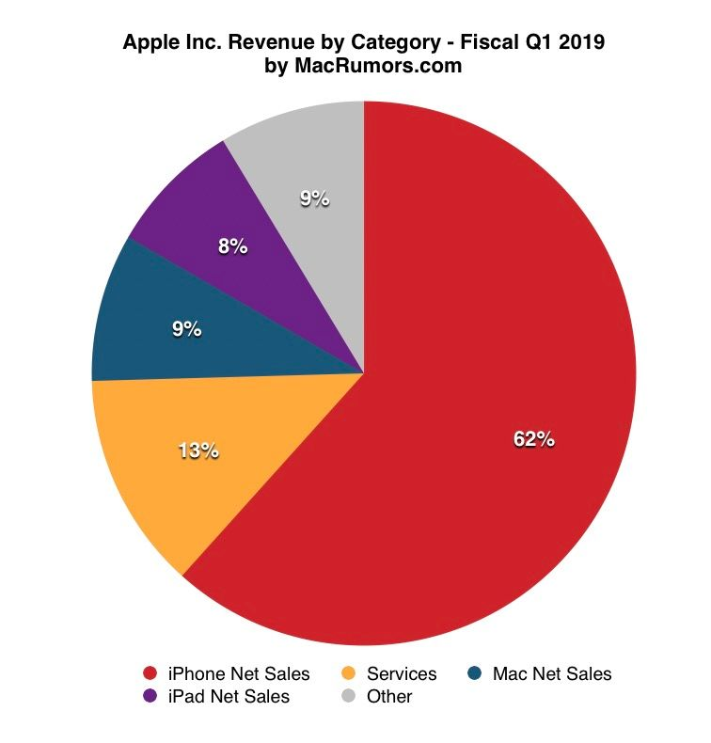
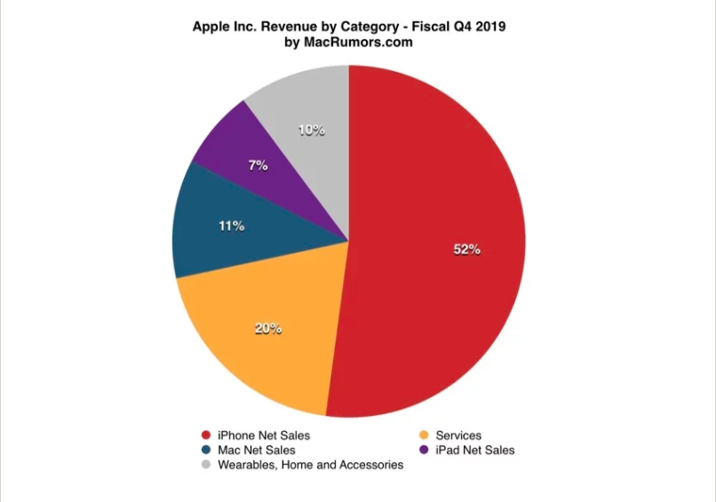
MMA 801 – Tutorial – Financial Fundamentals
Source:Source: MacRumors.com, https://www.macrumors.com/2019/01/29/apple-1q-2019-results/,
https://www.macrumors.com/2019/10/30/apple-4q-2019-results/

Slide 69
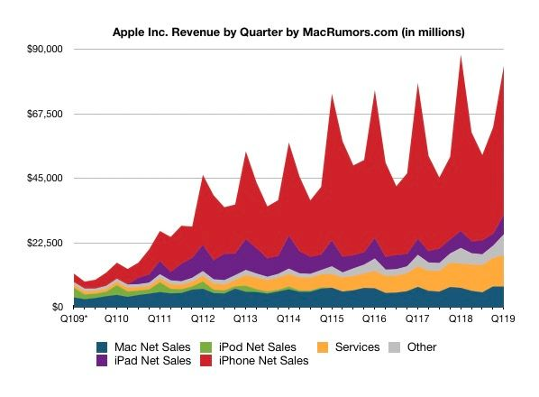
MMA 801 – Tutorial – Financial Fundamentals
Source:Source: MacRumors.com, https://www.macrumors.com/2019/01/29/apple-1q-2019-results/

Slide 70
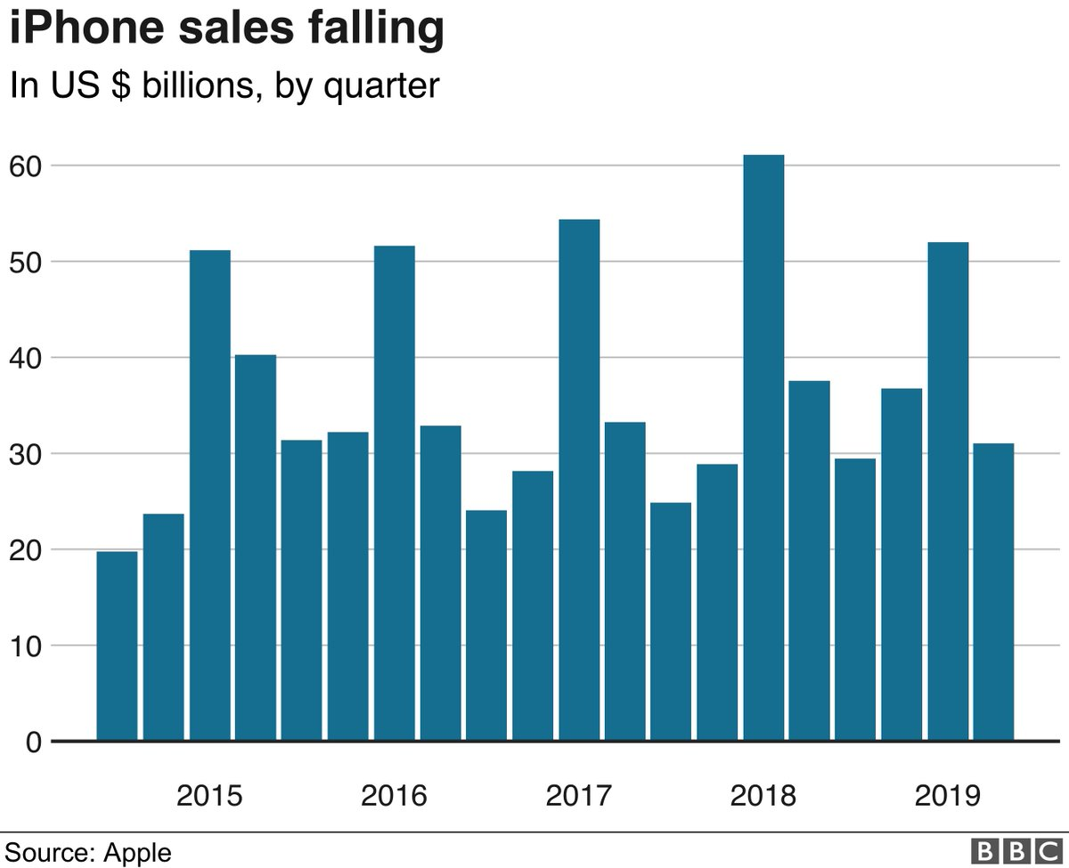
MMA 801 – Tutorial – Financial Fundamentals
Apple no longer reporting unit sales

Slide 71
Cost Ladder
MMA 801 – Tutorial – Financial Fundamentals
Selling Price
Value Chain Derivative
Profit Margin
Admin. & Corp. OH
Marketing, Sales & Service
Distribution
Total Costs
Processes & Transformation
Cost Ladder
Suppliers & Logistics
Design & Development

Slide 72
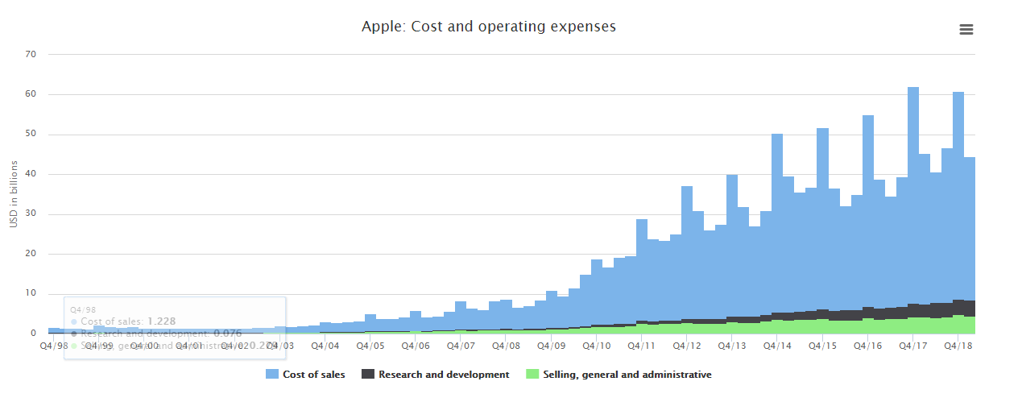
Apple Costs Structure – Macro Assessment
MMA 801 – Tutorial – Financial Fundamentals
Source: https://barefigur.es/companies/apple/cost-and-operating-expenses/

Slide 73
MMA 801 – Tutorial – Financial Fundamentals
Required Price Point
Thinking Forward – Projected Price/Cost Base Analysis
Future Needs
Product/Service Development
Unforeseen Contingency Fund
Program Expansion
IT Initiatives
Cost-Reduction Initiatives
Market Studies
Growth Initiatives
Capital Assets
Required Contingencies
Depreciation and Amortization Replacement
Debt Repayment
Inflationary Adjustments
Minor Equipment Replacement
Fixed (Semi-Fixed) Costs
Insurance
Utilities
Mortgage/Lease
Service Contracts
Centralized Services
SG&A Costs
Variable (Direct) Costs
Labour
Benefits
Statutory Obligations
Materials/Supplies
Transformation Costs

Slide 74
Here is How We Deliver Profit – Managing Your Margins
MMA 801 – Tutorial – Financial Fundamentals
Your Base Formula
Unit Profit = Unit Price – Unit Cost
Cost Layering
Which costs are direct (variable), and which costs are indirect (fixed, semi-fixed and committed).
What percentage of my costs are controllable in the near term?
How do my investment and operational decisions impact my cost structure?
What type of "Expense Creep" am I incurring?
Direct Cost Zone
$$$ Costs
Total Cost Structure
Indirect Cost Zone
Volume/Scale

Slide 75
MMA 801 – Tutorial – Financial Fundamentals
Statement of Comprehensive Income - Defines the underlying financial structure of the business model
Revenue Line
Impacted by demand shifts, price pressure, disruption, etc.
Managing the Margins
Total Cost Line
$$$
BEP
Direct Cost Zone – Variable Costs
Define…
Structure
Key Cost Drivers
Indirect Cost Zone – Fixed, Semi-Fixed, Committed Costs
Limited Control – Short Run
Volume, Quantity, Activity, etc.

Slide 76
The Value of BEP Analysis
MMA 801 – Tutorial – Financial Fundamentals
Operational BEP
Operational BEP with a profit objective
Organizational BEP – operational BEP, Profit Objective & DPR Requirements
Optimal Price Point Analysis
BEP = TR – TC = 0 Minimal Acceptable Business Position for the Short Term

Slide 77
BEP Formulas
MMA 801 – Tutorial – Financial Fundamentals
BEP (Units) = Total Fixed Costs (Price/Unit – VC/Unit)
BEP (Units) = Total Fixed Costs + Profit Obj. w/ Target Profit (Price/Unit – VC/Unit)
BEP ($) = Total Fixed Costs (1 – VC%)
BEP ($) = Total Fixed Costs + Profit Obj. w/ Target Profit (1 – VC%)

Slide 78
Benefits of Leverage
MMA 801 – Tutorial – Financial Fundamentals
ABC Corporation
$40,000,000 Asset Base
Option #1
$40,000,000 Equity
Debt = $0
Option #2
$10,000,000 Equity
Debt = $30,000,000 @ 6% interest per year
ROE = 8.75%*
EBIT of
$3,500,000
ROE = 17%*
EBT of
$1,700,000
Under Option #2 – Assume 4 equal $10,000 Investments
$1,700,000 x 4 = $6,800,000
* Disregard taxation rules and provisional adjustment factors at this time.

Slide 79
MMAI 801 – Tutorial – Financial Fundamentals
Risk of Leverage
ABC Corporation
$40,000,000 Asset Base
Option #1
$40,000,000 Equity
Debt = $0
Option #2
$10,000,000 Equity
Debt = $30,000,000 @ 6% interest per year
ROE = -2.5%*
EBIT of
-$1,000,000
ROE = -28%*
EBT of
-$2,800,000
* Disregard taxation rules and provisional adjustment factors at this time.

Slide 80
Forecasting and Budgeting Process
MMAI 801 – Tutorial – Financial Fundamentals
Market Analysis
Sales Forecast
& Cost Analysis
Development of Preliminary Pro-forma Statements
Upcoming Year Financial Resource Assessment
Preparation of Budgets
Comparison of Budget against Actual Results
Reassessment loops – to finalize preparation of budgets
Repeat process for next planning period

Slide 81
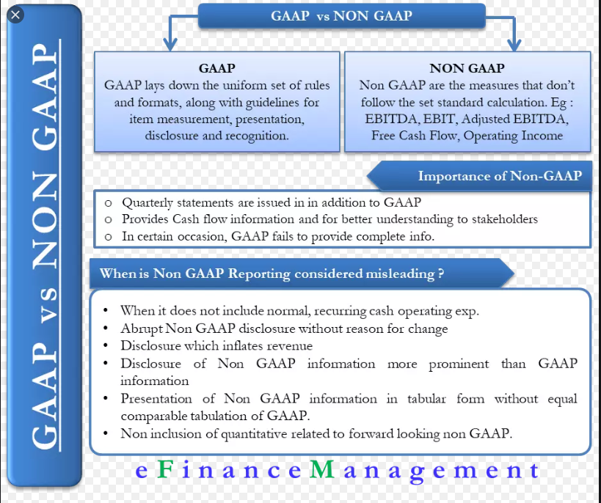
MMAI 801 – Tutorial – Financial Fundamentals

